Slide 1
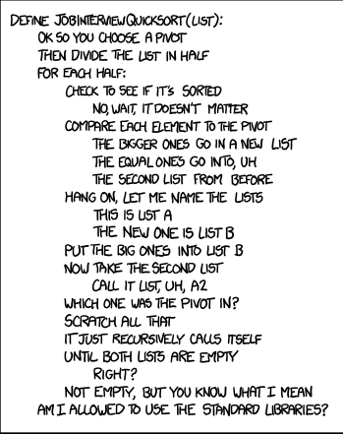

Slide 2

Notes:
Play video – how to get a job in times of crisis

Slide 3
Job Interviews

Slide 4
Do’s
Arrive early
Pay attention
Be prepared to ask questions
Research the company / position
Notes:
Arrive early: allow for weather, traffic
Pay attention: full focus on interviewer, don’t shuffle papers, rummage through your bag
Asking questions will be addressed in detail later

Slide 5
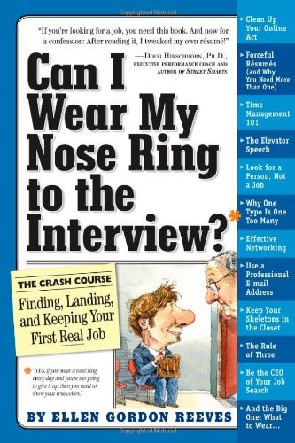

Do’s
Dress appropriately
Notes:
4:45
Dress appropriately: research company dress code; match the company dress code or be one step up; no wrinkles in clothing

Slide 6
Do’s
Keep it positive; smile
Be confident but not arrogant
Be honest, truthful
Be authentic
If appropriate, discuss what you learned from mistakes

Slide 7
Do’s
Bring a paper copy of résumé
Display professional behavior
Think out loud
How many ping pong balls fit into a 747?
How would you move Mount Fuji?
Which state should be eliminated from the United States?
Notes:
Professional behavior
Don’t cuss, chew gum, burp, take off your shoes, forget to shower
Do everything that is appropriate in a business setting

Slide 8
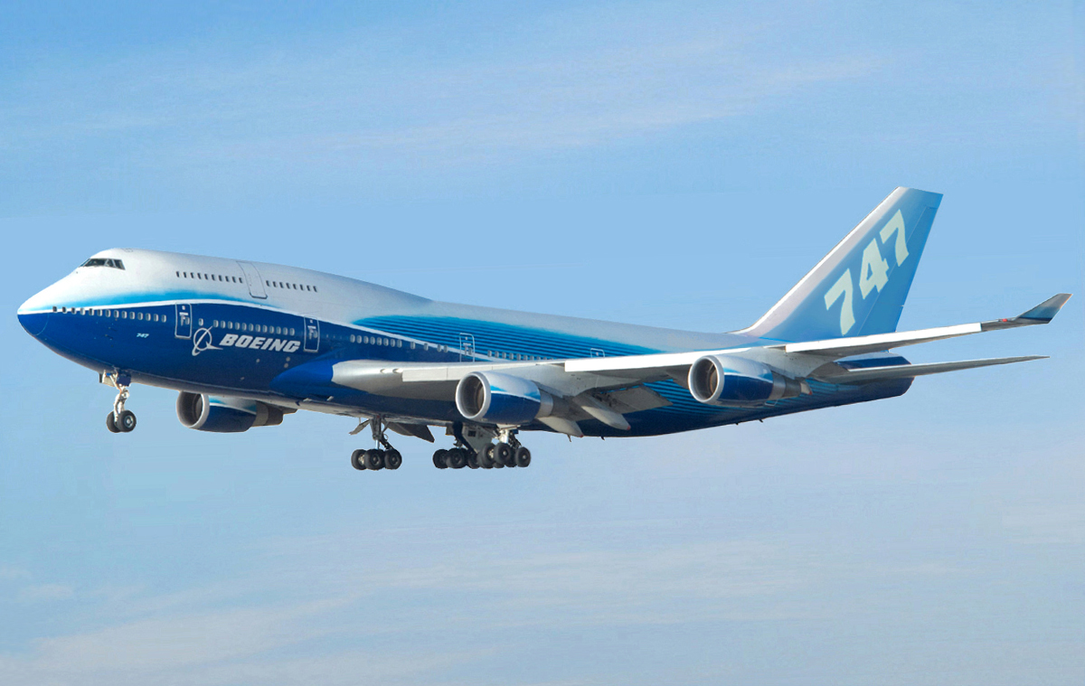
How many ping pong balls fit into a 747?
Notes:
Which model? Cargo or passenger?
Think before jumping into a solution
http://upload.wikimedia.org/wikipedia/commons/f/f4/Boeing_747-400_Dreamliner_livery.jpg

Slide 9

How would you move Mount Fuji?
Notes:
Evaluate consequences first (environmental impact statement, tourism) before jumping into a solution
http://4.bp.blogspot.com/-uJkM02Gnw7g/USTSo8KoA7I/AAAAAAAAAdE/3X4OSlrCto0/s1600/Japan-Mt.Fuji_.jpg

Slide 10
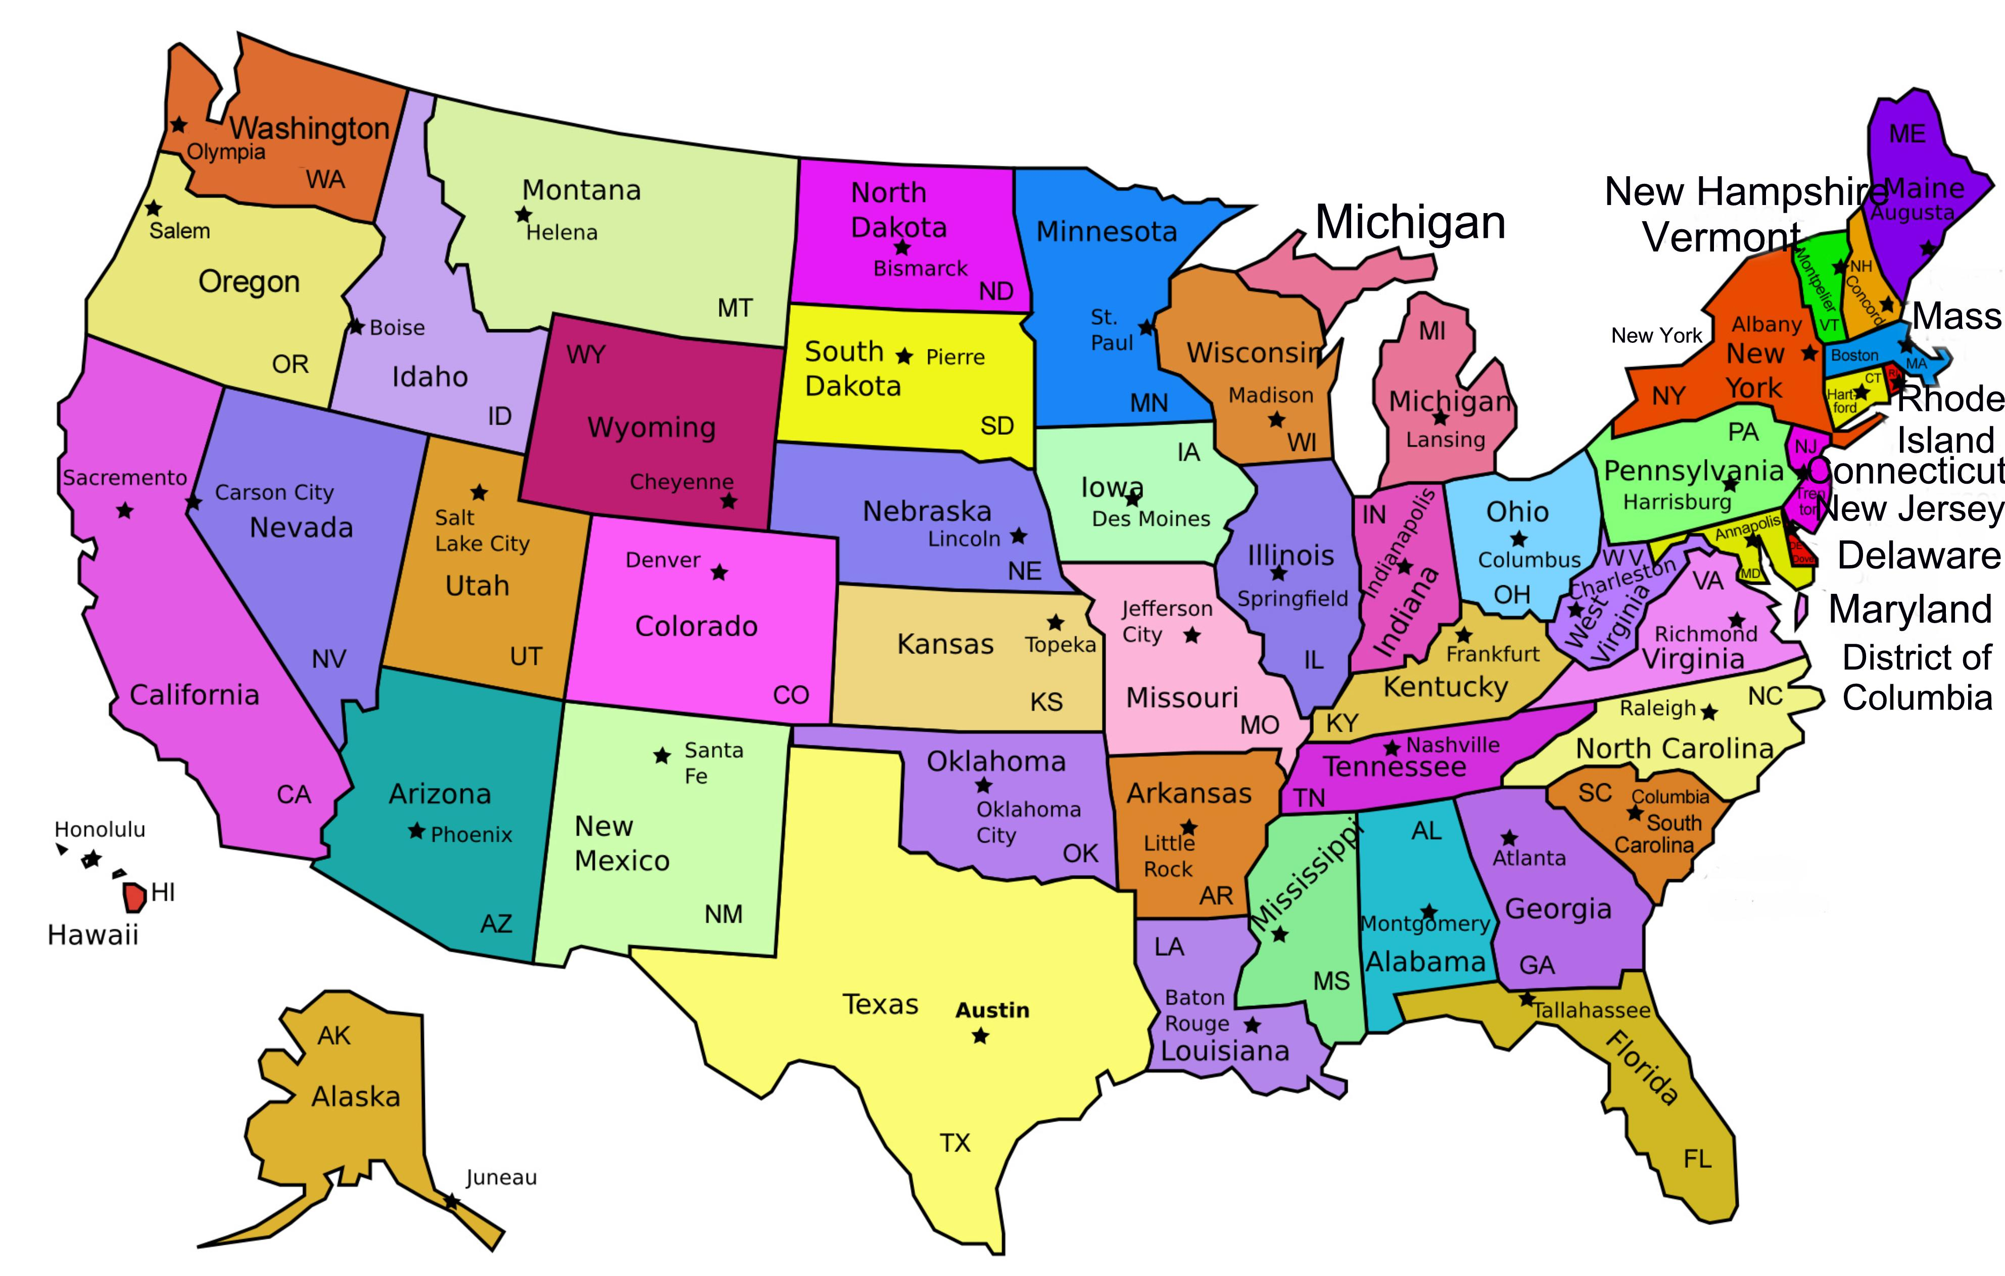
Which state should be eliminated from the United States?
Notes:
First, establish criteria. Then evaluate each state.
Or which state could survive being eliminated?
Object evaluation
http://www.jurisdictions.steamforum.com/images/states_imgmap.jpg

Slide 11
Do’s
Prepare answers to standard questions
Make prepared answers sound spontaneous
Notes:
Standard questions
Tell me about yourself
What is your greatest strength?
What is your greatest weakness?
Tell me about a time when …

Slide 12
Standard Questions
“Tell me about yourself.”
Not an invitation for an autobiography
Focus on academics and experience
Notes:
About yourself example: “At my current job, I was instrumental in reducing overtime by 50%.”

Slide 13
Standard Questions
“What is your greatest strength?”
Relate your answer to the company or position

Slide 14
Standard Questions
“What is your greatest weakness?”
Genuine weakness
Include what you do to compensate
Notes:
Genuine weakness: not “I work too many hours”

Slide 15
Do’s
Memorize ≥4 stories of achievement at work (or school)
Circumstance
Action
Result
Behavioral question areas
Teamwork
Leadership
Communication
Problem solving

Slide 16
Do’s
Listen and adjust your strategy as necessary
Know the salary range you’re willing to accept
Don’t raise the subject
Disclose it only if forced to
Provide a range
Notes:
“I’ll need more information about the job and the responsibilities involved before we can begin to discuss salary. Can you give me an idea of the range budgeted for this position?”

Slide 17
Organize Proposal Groups
Notes:
Start here!

Slide 18
Job Interview Question
If 1½ chickens lay 1½ eggs in 1½ days, how long will it take two chickens to lay 32 eggs?
… how oft would I have gathered you as a hen gathereth her chickens, and ye would not.
3 Nephi 10:5
Notes:
Calculators are allowed

Slide 19
Solution
1.5 chickens, 1.5 eggs, 1.5 days
3 chickens, 3 eggs
1.5 days
1 chicken takes 1.5 days to lay 1 egg
1.5 days chicken / egg * (32 eggs / 2 chickens)
1.5 * 16
24 days

Slide 20
Nature of the Problem
Behavioral or technical?
Notes:
Technical
While a chicken lays her eggs sequentially, multiple chickens lay in parallel.
Does the candidate see where things are sequential and where things are concurrent?

Slide 21
Sample Question
What is your greatest pet peeve?
Dangers
Whiner
Trivial
Insincere
My answer
Blocking of sidewalks
Notes:
My answer: I walk almost everywhere, 3 months on a tank of gas, people block sidewalks and force me into street, as I walk by I smile because it’s silly to have sidewalk rage
Note: revealed personality, show coping mechanism

Slide 22
Sample Question
How many people watched YouTube in the last hour?
Obvious answer: check the server logs; however …
Listen to music without watching
Group video view (one connection, many people)
Video plays, person(s) gone
Real question: at what cost to obtain what accuracy?
Notes:
Start 10 minute video 5 minutes before the hour, but kill it just before the hour

Slide 23
When You Don’t Know the Answer
Here’s what I know
Here’s what I don’t know
Here’s how I’ll figure it out
from CareerBuilder.com
http://www.cnn.com/2011/09/26/living/answer-questions-cb/index.html

Slide 24
Don’ts
Badmouth former employers or coworkers
Bring your cell phone
Forget you are being evaluated
Ask what’s in it for you
Notes:
Evaluated: including the receptionist, secretary
Don’t get too comfortable – e.g., public grooming
including meals
What’s in it for you
Salary, benefits, vacation, promotions, raises, etc.

Slide 25
Don’t
Get too personal; confide
Ramble
Give too-brief answers
Let nerves take over
Notes:
Nerves: throw up on interviewer, tap your pen, fiddle with papers, twist a ring

Slide 26
Taboo Topics
National origin / citizenship
Race / color / ethnicity
Age
Marital / family status
Affiliations
Personal (e.g., gender)
Disabilities
Notes:
The candidate should not raise these issues

Slide 27
Handling Taboo Topics
Seek for the “legal” question behind the “illegal” question
Answer the intention, not the illegal question
Notes:
Example: Do you have a family?
Answer: I can travel. I can work some evenings and weekends.

Slide 28
National Origin / Citizenship
Illegal
Are you a US citizen?
They probably meant
Are you authorized to work in the United States?
Are you qualified to receive a US security clearance?
Notes:
Legal – the information they are probably looking for

Slide 29
Race / Color / Ethnicity
Illegal
Describe your ancestry.
What race are you?
They probably meant
They’re racists.
Notes:
There is no legal question regarding race / color

Slide 30
Age
Illegal
How old are you?
When will you retire?
They probably meant
Are you over 18?
How long do you anticipate working for us?
Notes:
Can be asked only if age is an issue
Over 40 - ageism

Slide 31
Marital / Family Status
Illegal
What’s your marital status?
How many children do you have?
Do you plan to have a family? When?
They probably meant
Are you willing to relocate?
Are you willing and able to travel?
Are you willing and able to work overtime?

Slide 32
Affiliations
Illegal
What church do you belong to?
What clubs do you belong to?
They probably meant
Are you willing and able to work weekends?
Notes:
Interviewers can inquire regarding professional societies that are relevant to the position

Slide 33
Personal
Illegal
Are you male or female?
How often are you sick?
Do you see a psychiatrist for stress?
They probably meant
What is your attendance record at work?
How do you handle stress?
Notes:
Gender questions are generally illegal

Slide 34
Disabilities
Illegal
Do you have any disabilities?
How is your family’s health?
They probably meant
Are you able to perform the essential functions of the position?
Do you anticipate any problems with being at work on time every day?

Slide 35
Remember
Your attitude says more than your answer

Slide 36
After the Interview
Send a thank-you note
Follow up, but not aggressively
Keep a journal
Learn from your mistakes
Keep searching
Notes:
More on thank you note later

Slide 37
Send a Thank You Note
Email
Each interviewer
No group thank you missives
Soon, but not immediately
Notes:
Don’t send exactly the same text to each interviewer
Soon – keep your name current with interviewers

Slide 38
Be Sure To …
Keep it short
Proofread

Slide 39
Content
Thank you
Opportunity
Time
Highlight
Notes:
Highlight something about the job, the company that stood out to you

Slide 40
Content
Interest in job
Why you want the job
Why you are a good fit

Slide 41
Content
Address issues, concerns
Continued conversation is good
Notes:
Issues, concerns – if you didn’t answer a question well
Continued conversation – example: follow up question

